Slide 1
Team 7: Bug Tornado
Telco Customer Churn
Member: Yuan Dang,
Changhong Zhang,
Zihan Ye,
Jinbo Li

Slide 2
What factors influence customer churn?
Dataset
From a telephone company in California of 7043 customers
Demographic information
Customer account information
Services that each customer has signed up for
Whether customer has left within last month (target variable)
Notes:
Vivian 20 variables

Slide 3
Things Look at for Analysis
Bar plots for each categorical variable
Kde plots for each continuous variable
Correlation plot
Violin and scatter plots of high correlated variables
Scatterplot(with jitter)
Notes:
vivian

Slide 4
Exploratory Data Analysis (EDA)
Notes:
Zihan Ye

Slide 5
Bar Plot
Analyze how each categorical variable influences the churn.
Why do we use bar plot:
Easy to show each data category in a frequency distribution
Summarize a large amount of data in a visual, easily intepretable form
There are 16 categorical variables in data set, we will separate it into several groups
Notes:
Zihan Ye
Analyze how each categorical variable influences the churn
Reason to use bar plot
Separate into groups

Slide 6
Bar Plot
Customers’ basic information
Phone service information
Internet information
Streaming information
Payment Information
Notes:
Zihan Ye

Slide 7
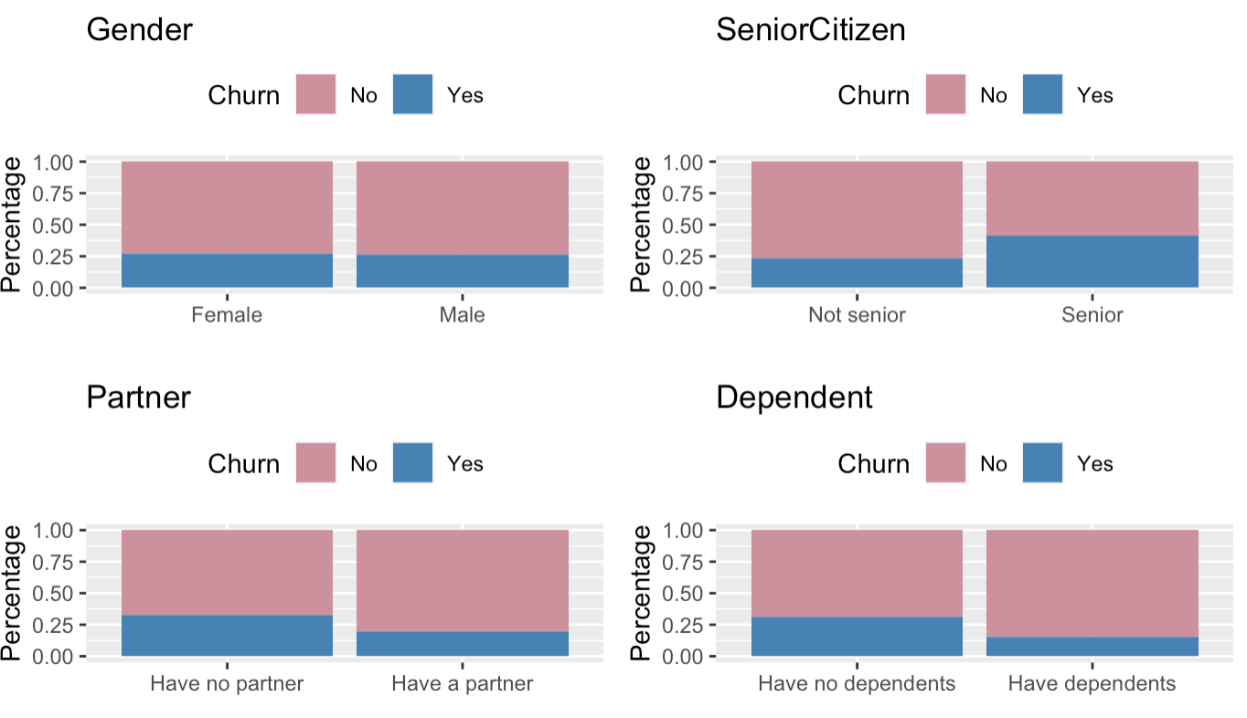
Customers’ Basic Information
Notes:
Zihan Ye

Slide 8
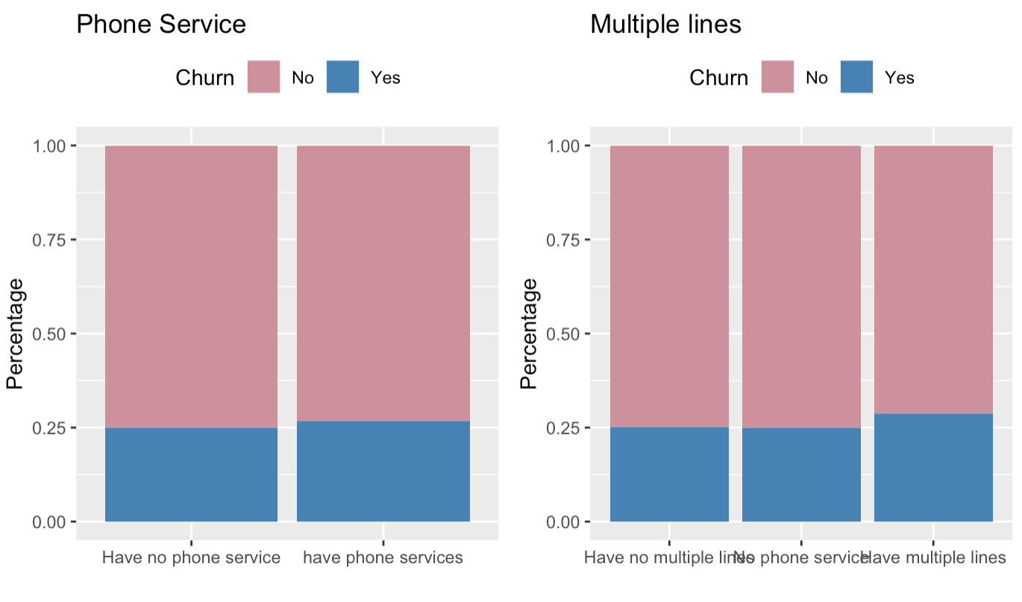
Phone Service information
Notes:
Zihan Ye

Slide 9
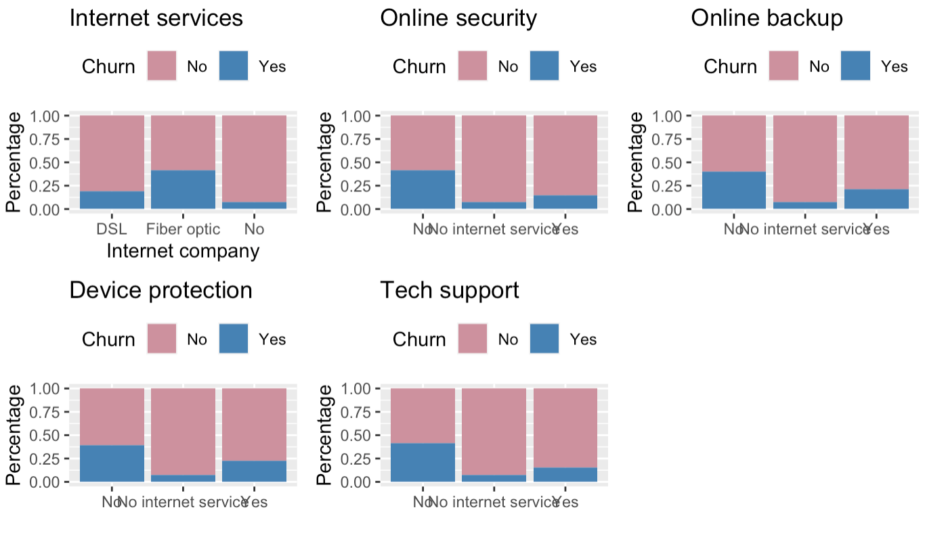
Internet Information
Notes:
Zihan Ye

Slide 10
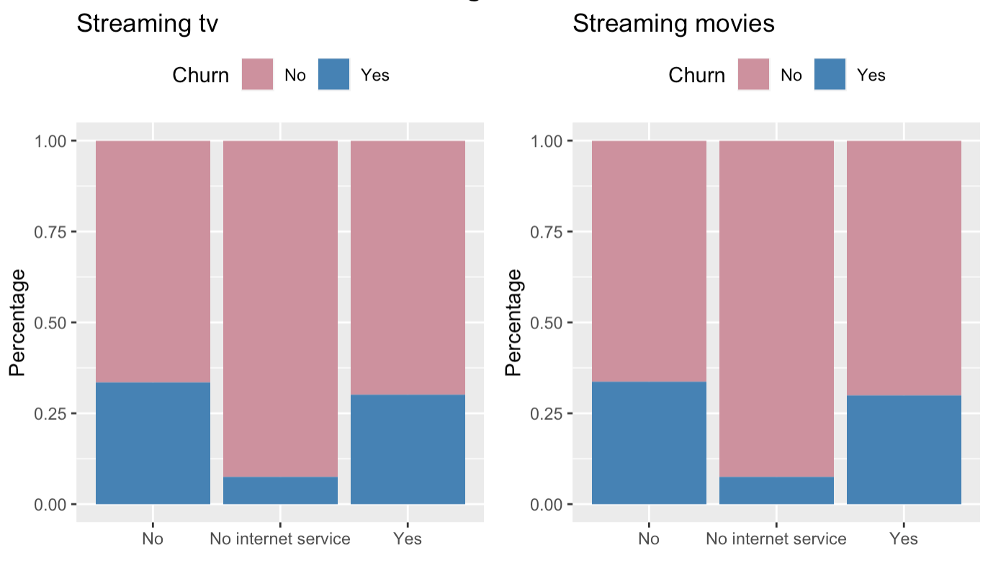
Streaming Information
Notes:
Zihan Ye

Slide 11
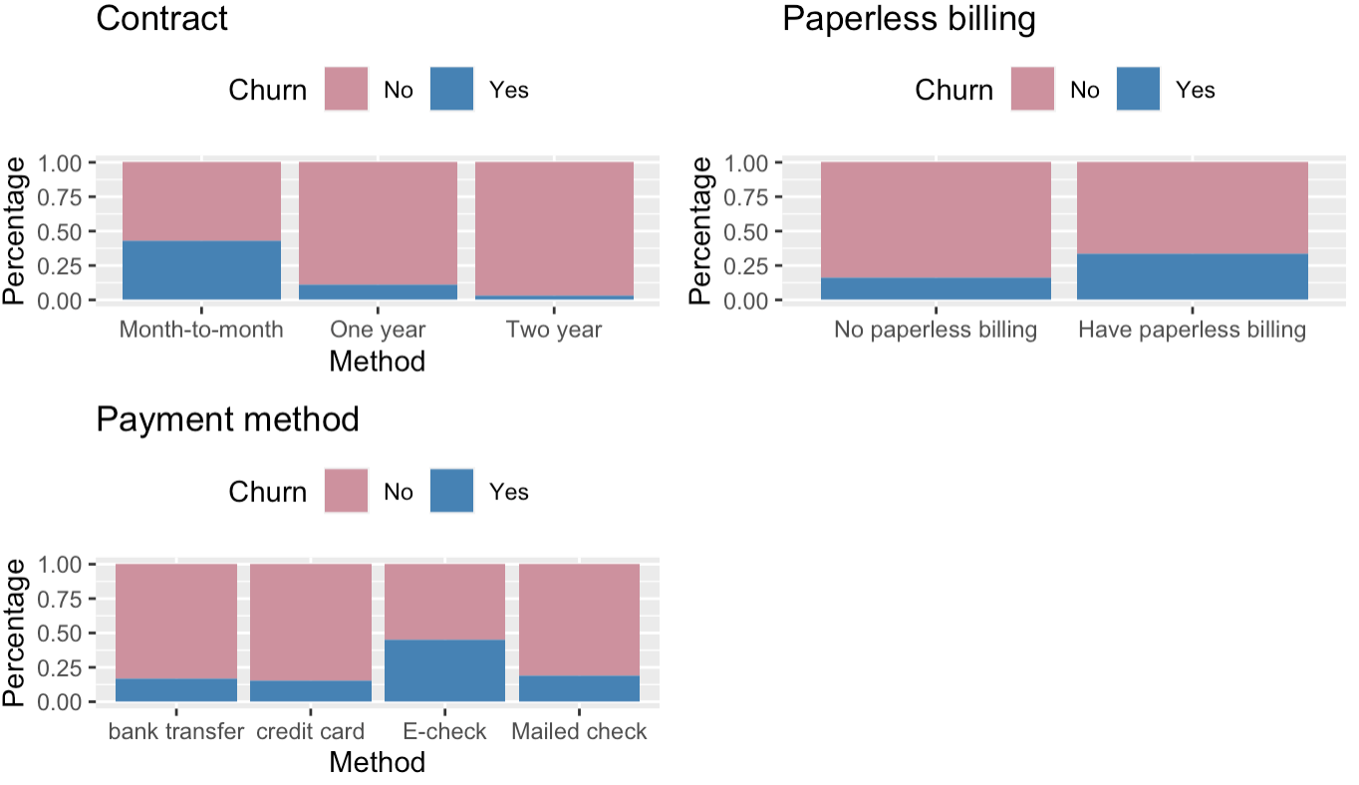
Payment Information
Notes:
Zihan Ye

Slide 12
Kde plot (Kernel Density Estimation plot)
Kernel Density Estimation plot
Why do we use kde plot:
Easily observe distribution
Won’t be affected by sample size
Notes:
Jinbo Li

Slide 13
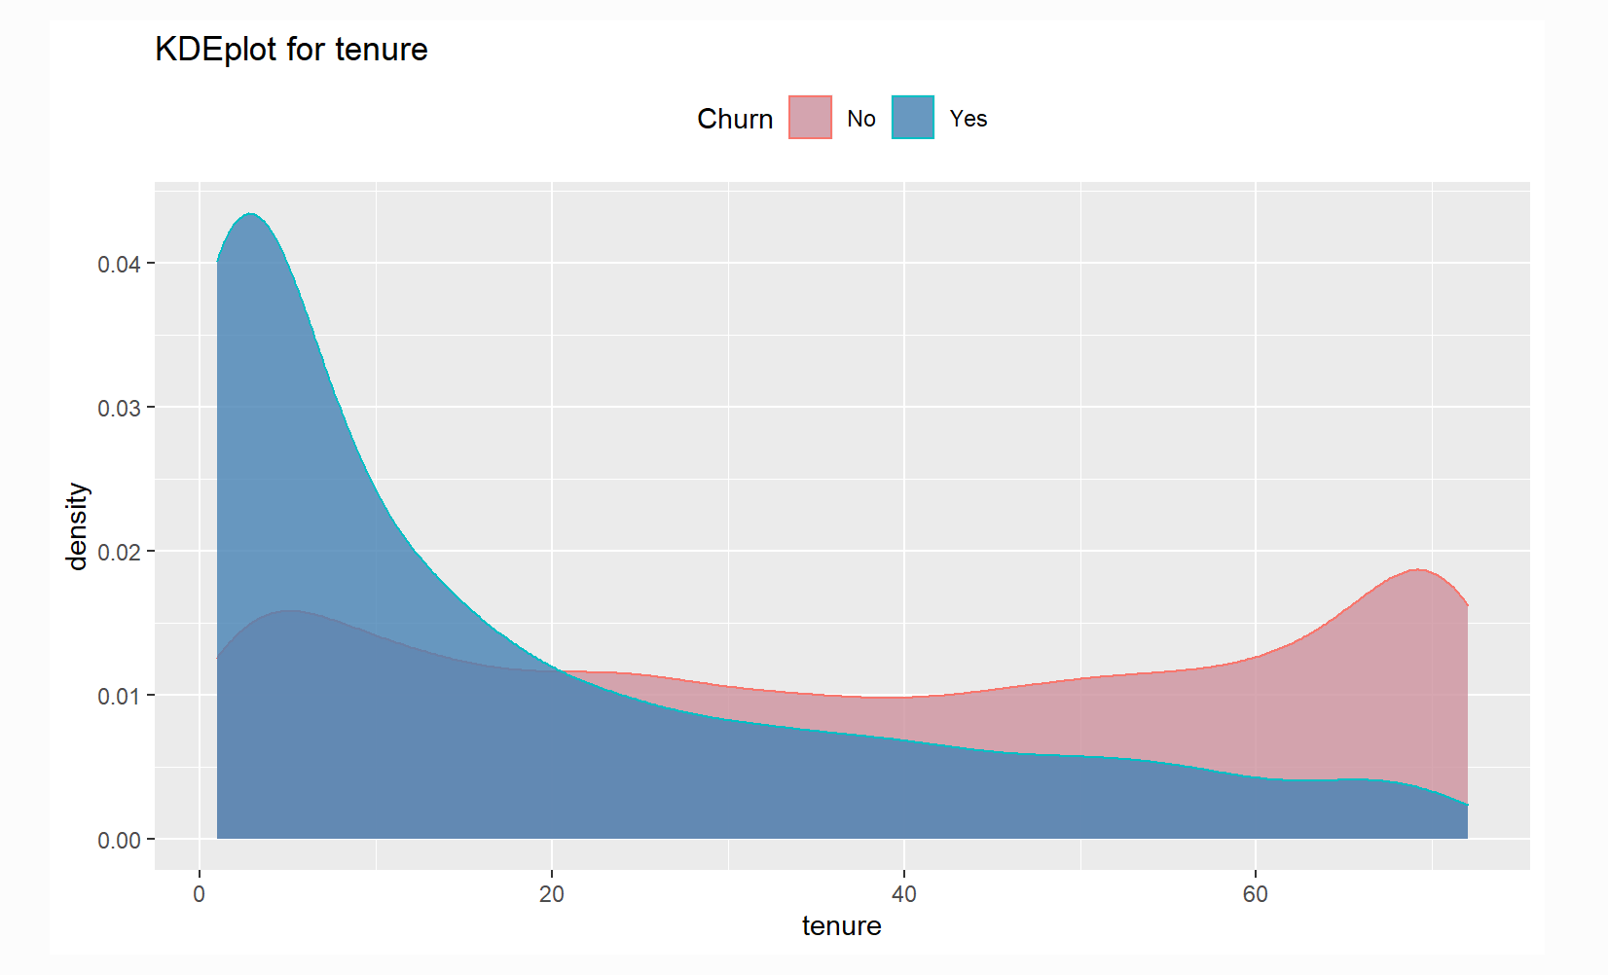
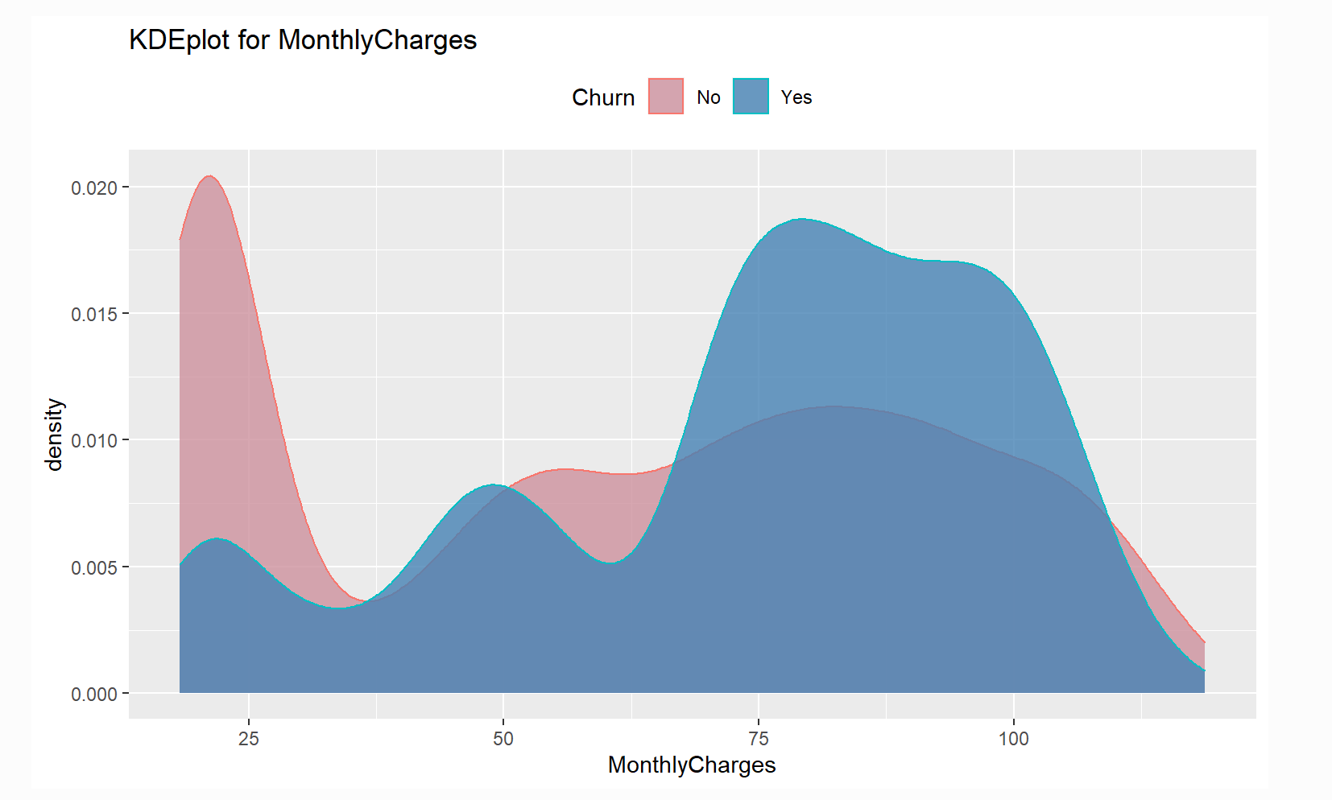
Customers with lower tenure are more likely to churn
Customers with higher monthlycharges are also more likely to churn
Notes:
Jinbo Li

Slide 14
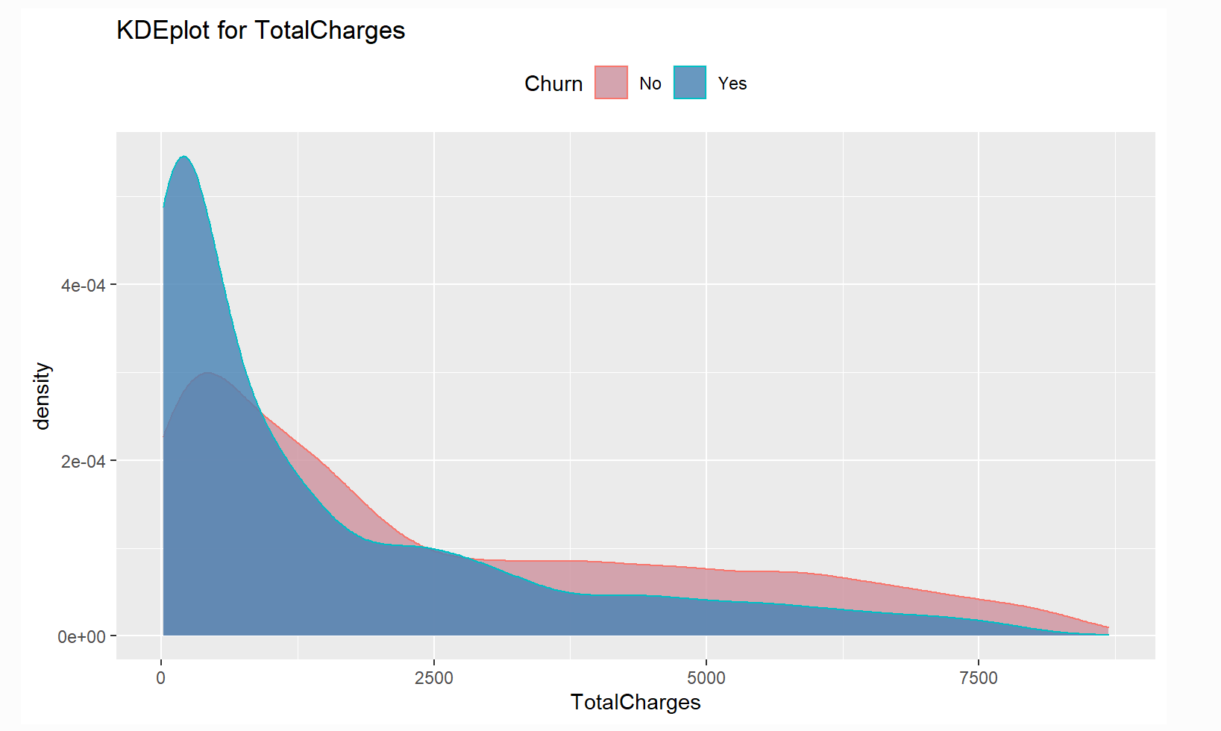
Churn and non churn customers have similar distributions
Notes:
Jinbo Li

Slide 15
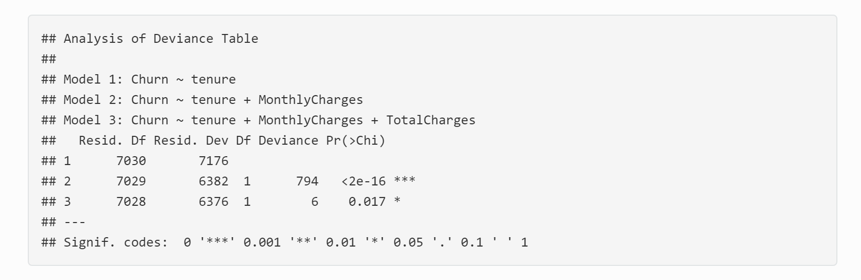
Logistic Model
Notes:
Jinbo Li

Slide 16
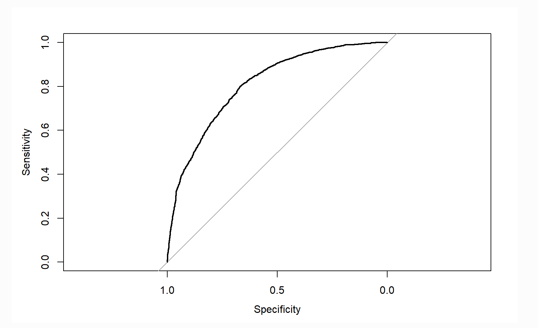
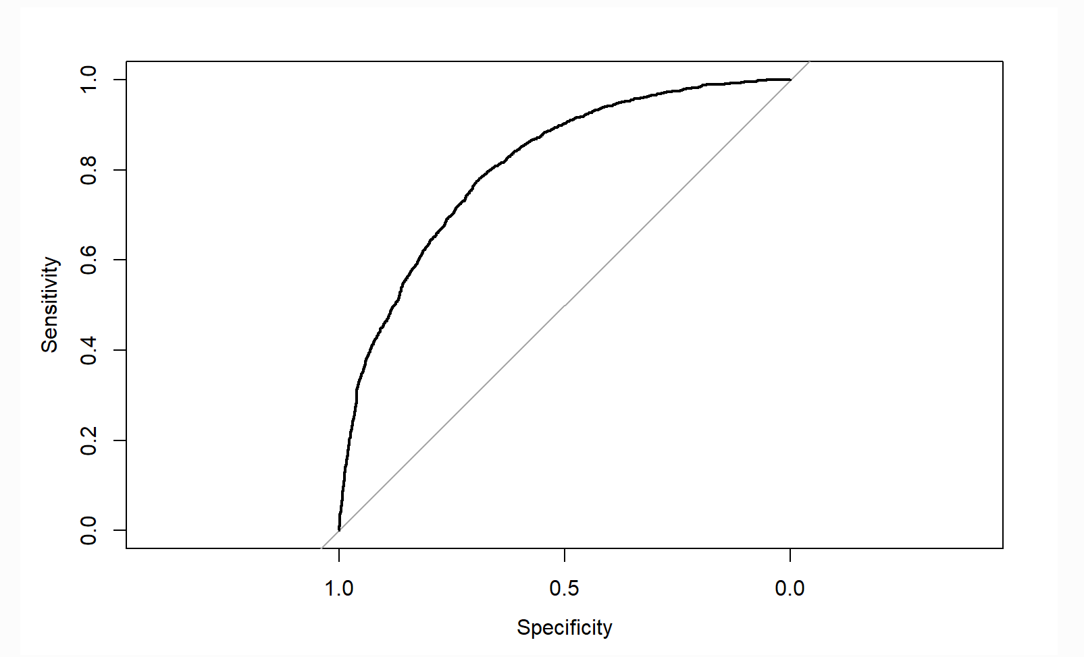
AUC - ROC Curve
AUC (Area Under The Curve) - ROC (Receiver Operating Characteristics)
Model 2
Model 3
Area under the curve: 0.808
Area under the curve: 0.809
Notes:
Jinbo Li

Slide 17
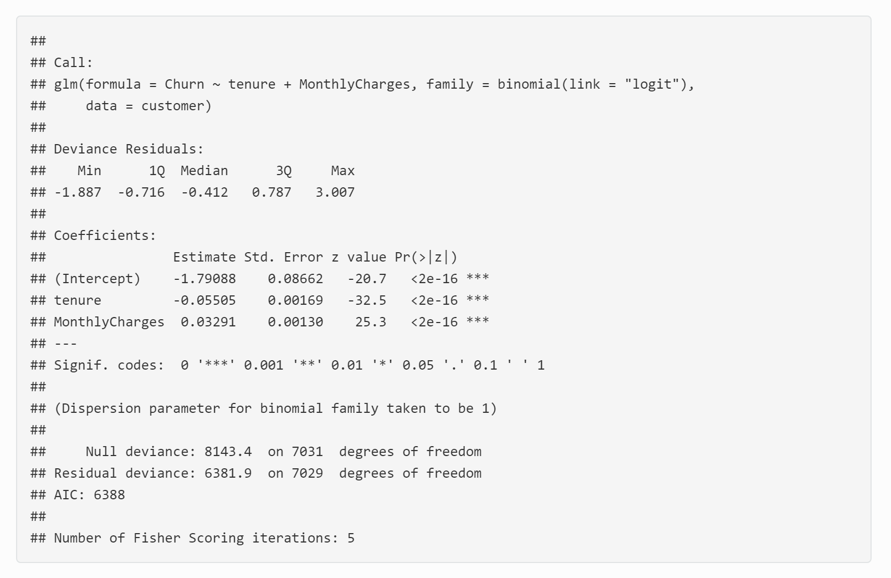
Best Model
Notes:
Jinbo Li

Slide 18
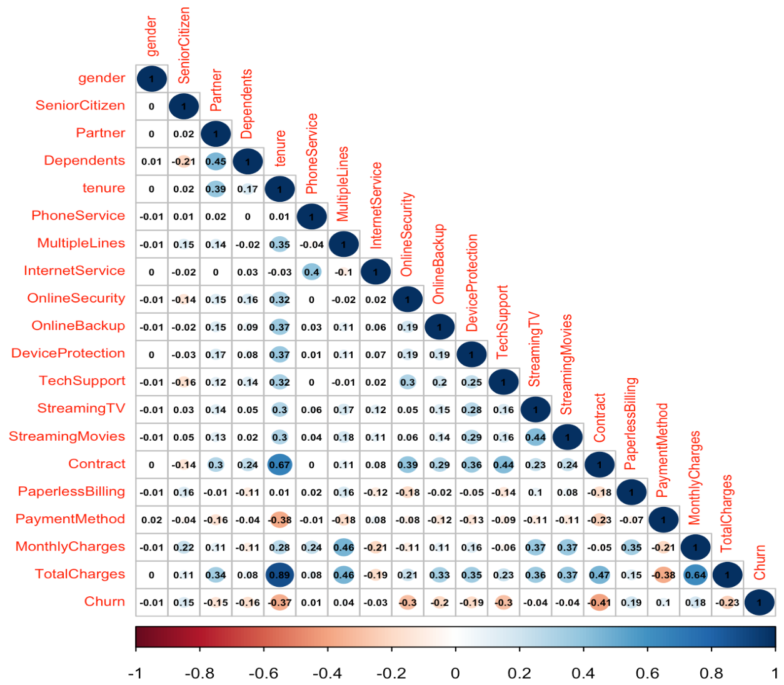
Correlations
Churn negative correlated with online security and technical support.
Churn negative correlated with continuous variable contract and tenure
Total charge and contract are strongly correlated with tenure
Notes:
vivian

Slide 19
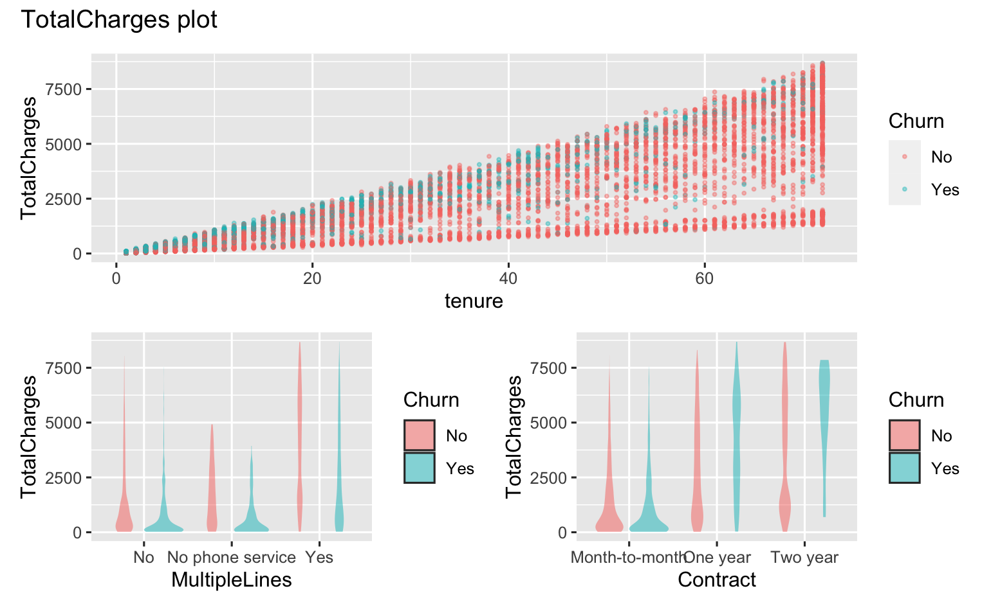
Is Total Change will influence the churn rate with other variables?
high total charge + any tenure
no phone service & no multiple lines + short tenure
a month-to-month contract + short tenure

Slide 20
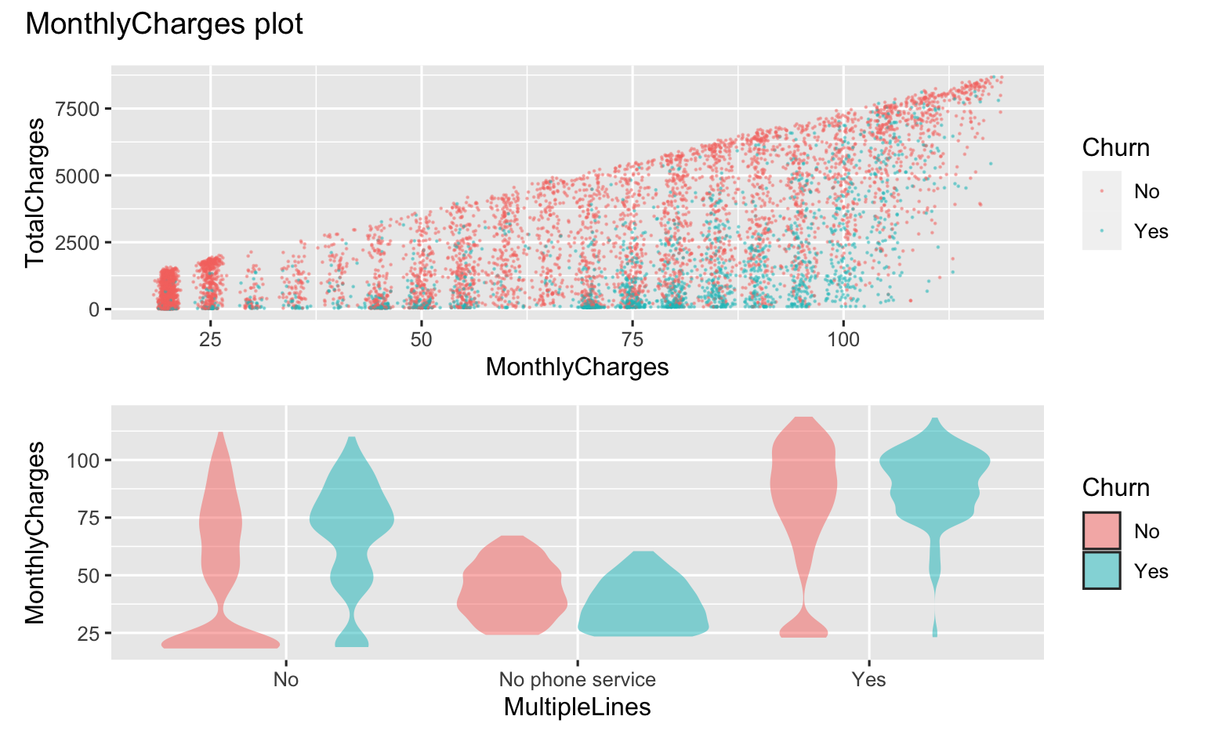
Is Monthly Change will influence the churn rate with other variables?
high monthly charge + before their total charge increasing
no multiple lines service:
30 < monthly charge < 50 &
monthly charge > 70
no phone service:
monthly charge ↑ churn rate ↓
have multiple lines service:
monthly charge > 70

Slide 21
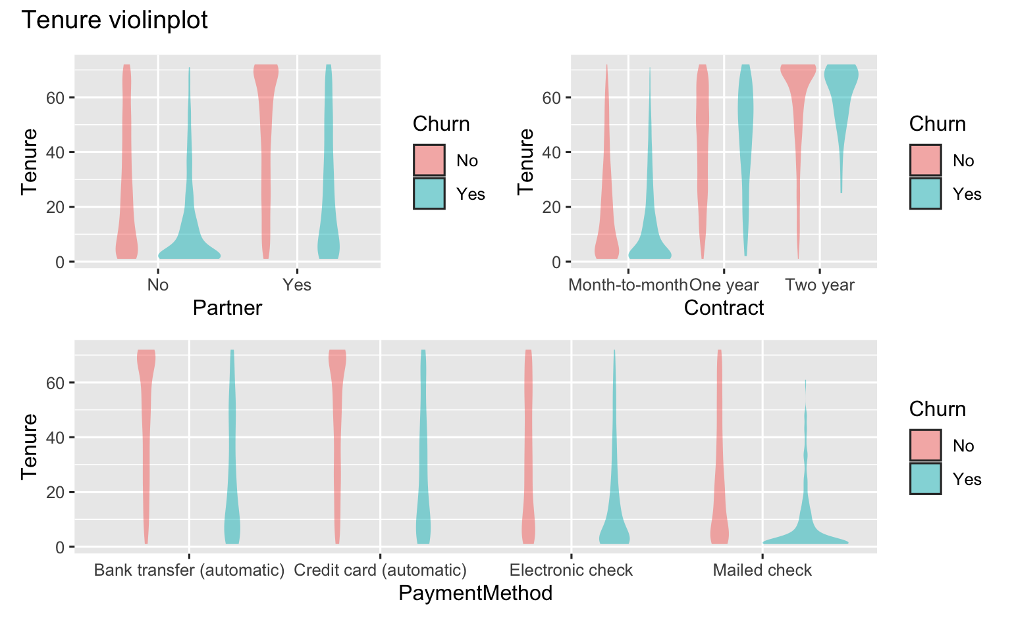
Is Tenure will influence the churn rate with other variables?
no partner + short tenure
month-to-month contract + short tenure
2 year contract + long tenure
electronic check / mailed check + short tenure

Slide 22
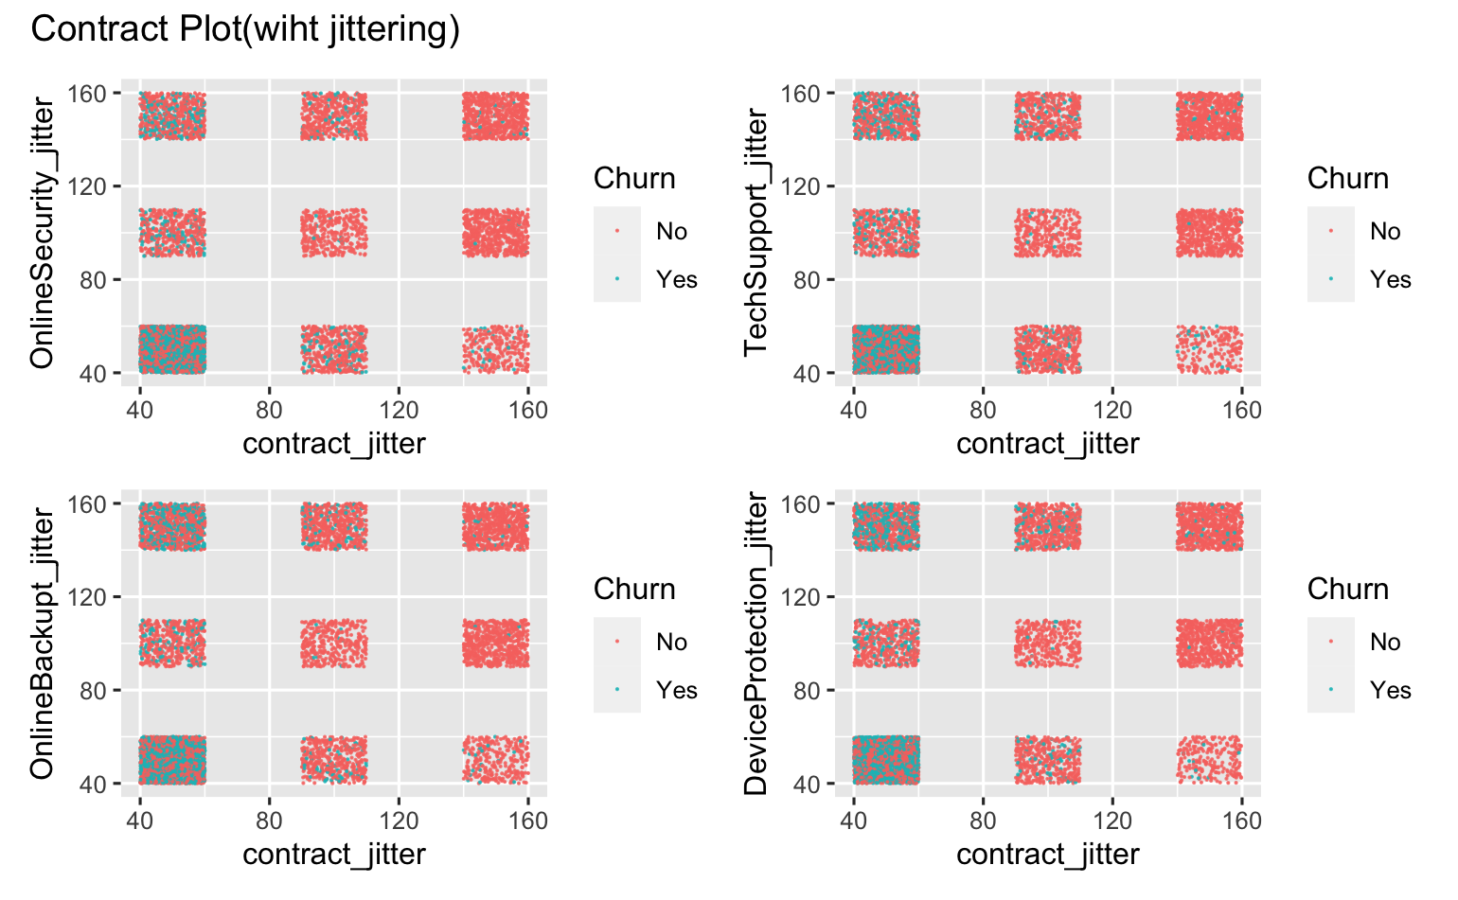


Is Contract will influence the churn rate with other variables?
month-to-month contract
& have no service of these 4 variables
Except Devices Protection: not as big an impact as no DP service, but still an impact

